Slide 1


Slide 2

What does LGBTQIA+ mean?
Does anyone know what the acronym stands for?

Slide 3
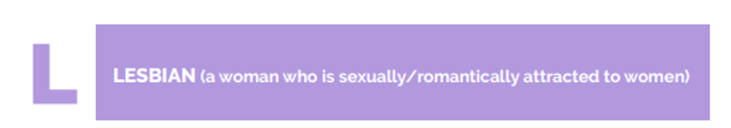




Slide 4



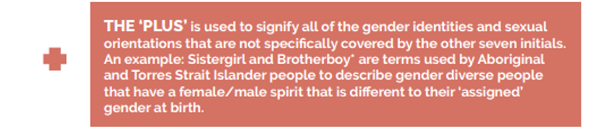

Slide 5
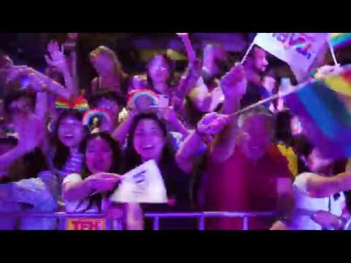
Wear It Purple Day

Slide 6
On Thursday 27th of August, students are encouraged to wear a touch of purple with their uniform.
Purple socks
Purple nail polish
Purple scarf
Purple in their hair
Purple ribbons

Slide 7
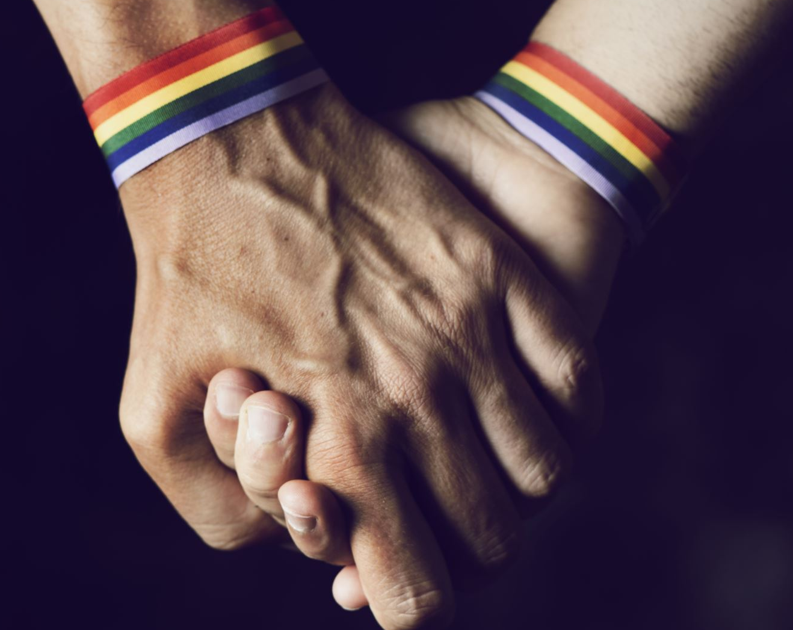
How does Kew High School support Young People in the LGBTQIA+ Community
Student Club – Stand Out
LGBTQIA+ Student Inclusion Policy
Gender Affirmation process
Celebrating significant events
Wear it Purple Day
IDAHOBIT day

Slide 8

‘Stand Out’ Student Club
‘Stand Out’ group for students identifying as LGBTIQ+ and their allies. The group meets to discuss ways in which our school can celebrate and support the diversity that makes our school so special.
An Inclusive school that accepts and celebrates everyone, and this is our chance to contribute ideas and energy to such events and initiatives as:
IDAHOBIT Day
Wear it Purple Day
Identifying and promoting Inclusive behaviours and Language
Weighing in on how school processes and procedures can best include and support LGBTQI+ members of our community.

Slide 9

LGBTQIA+ Student Inclusion Policy

Slide 10

Purpose
The purpose of this policy is to ensure that Kew High School complies with and reflects the Department of Education and Trainings policy in supporting Lesbian, Gay, Bisexual, Trans and gender diverse, Intersex, and Queer and questioning (LGBTIQA+) students attending Kew High School.

Slide 11

What’s included in the Policy?
Contents
1) Definitions
2) Processes and procedures a. Legal considerations
b. Department requirements
c. Commitments of Kew High School for LGBTQIA+ inclusion
d. Promoting inclusive classroom practice at Kew High School
e. Gender affirmation support plans
f. Camps and Excursions
g. Understanding confidentiality
h. Parental consent

Slide 12
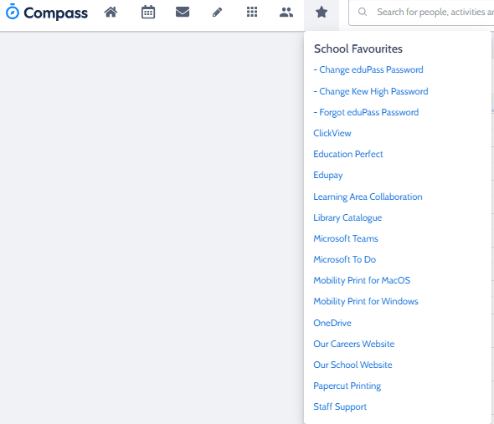
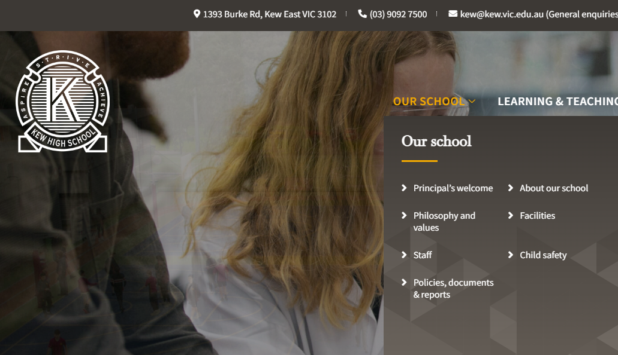
Where is it located?

Slide 13
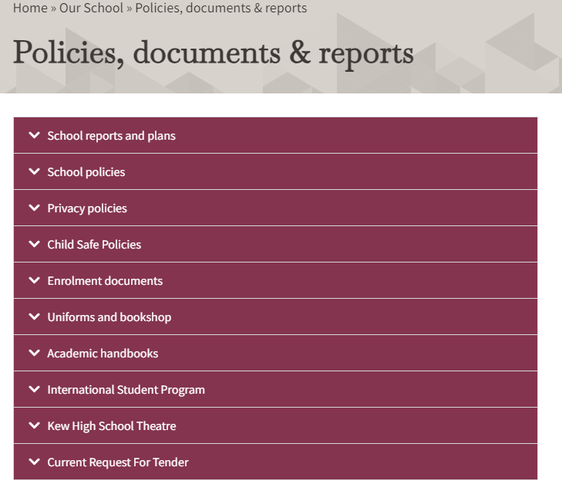
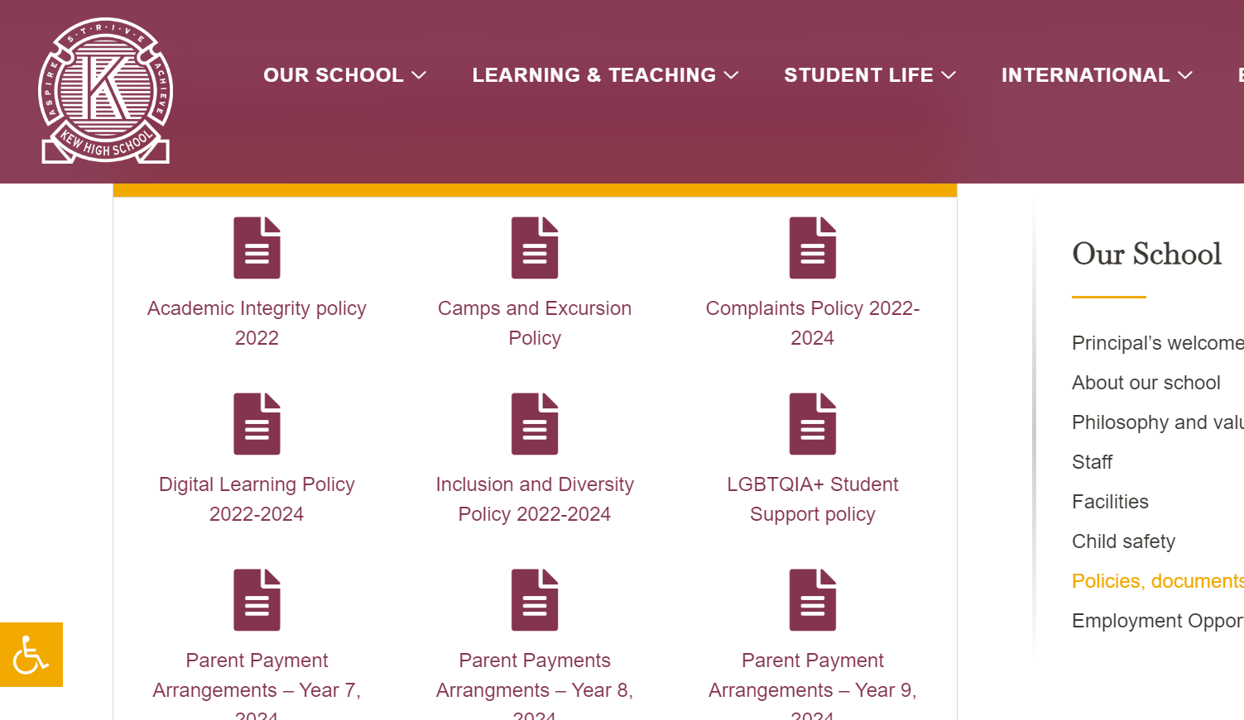
Where is it located?

Slide 14
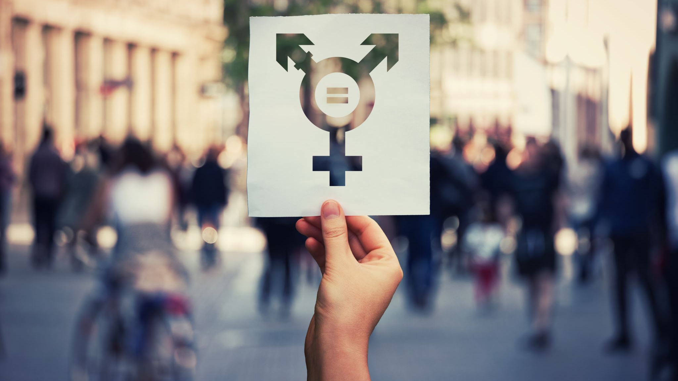
Gender Affirmation Process

Slide 15
What is gender affirmation?
This is when a person is going through the process of affirming the gender that they have always or have come to understand themselves to be. Some people say that they are ‘transitioning’ from one gender to another. Others use the idea of ‘affirming’ their gender because they are literally affirming who they are.

Slide 16
How is this supported at KHS?
The KHS community welcome and support the opportunity to work with young people who want to explore the possibility of affirming their gender.
To start the conversation about affirming gender, students can write to:
wellbeing@kew.vic.edu
Or to a specific member of the wellbeing team asking if they can make an appointment to discuss this further.

Slide 17
What happens when someone affirms their gender at school?
Changing pronouns on Compass, reports and other school documents (She/her, he/him, they, them etc)
It is specific to the person
Changing the gender listed on Compass, class lists and related documents (male, female, X)
The student will have complete control and ownership of the process and will be able to decide what they want to occur.
Changing their preferred name that may better reflect their gender

Slide 18
The possibilities
Changing
Changing the gender listed on Compass, class lists and related documents (male, female, X)
Choosing
Choosing a new name that may better reflect their gender
Clothing
KHS currently has a non-gendered uniform. There is no such thing here as a Male/Female uniform
Using
Using the facilities that align with their affirmed gender
Amending
Amending documents to match their gender identity, e.g., school records
Participating
Participating in activities in alignment with their gender identity, e.g., sport
Changing
Changing pronouns on Compass, reports and other school documents (She/her, he/him, they, them etc)

Slide 19

Support
Support can be provided to discuss the changes with your family/friends
Support provided to access external agencies such as transcend.or.au

Slide 20
Students are encouraged to wear a touch of purple on Thursday 27h August - purple socks, purple scarf, purple in their hair, purple nail polish, this is to be worn with their normal school uniform.
Wear It Purple day is NOT casual dress day.

